Slide 1
3D Peek Printer
Senior Capstone Design

Slide 2
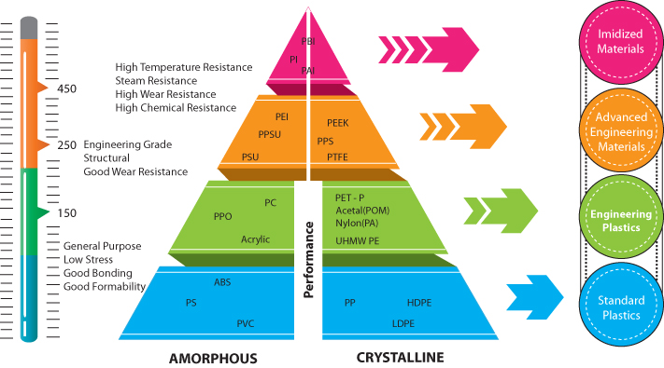
3D Printing Technology
Pros
Low machine cost
Low per-unit print cost
Rapid Production
Low size footprint
Wide availability
Cons
Dimensionally inaccurate
±0.1mm vs ±0.005mm for CNC
Limited object size
Low strength
Low temperature
Source: https://www.cil.co.th/engineering-plastics/

Slide 3
Market Analysis
 | Max Extruder Temp. (°C) | Max Bed Temp. (°C) | Max Chamber Temp. (°C) | Build Volume (mm³) | Price ($)
Average Commercial PEEK Printer | 490 | 193 | 165 | 5.01e7 | 61,000
Intamsys Funmat HT | 450 | 160 | 90 | 1.76e7 | 6,000
Aon-M2+ | 450 | 200 | 135 | 1.30e8 | 50,000
3DPP | 450 | 200 | 80 | 1.12e8 | 2,500
Intamsys Funmat HT
10x smaller build volume
Double price
Aon-M2+
Similar build volume
20x price

Slide 4
Design Requirements
Functional Requirements
Respond to movement commands in the X, Y, Z, and extruder directions
Heat nozzle to 450 °C, bed to 200 °C, chamber to 80 °C
Print all common filament types without heated chamber
Can print PEEK/PSU object
Print volume of 300x280x1330mm
Operate at maximum chamber temperature for 3 days continuously
Usability Requirements
System can operate on a local 20A breaker without heated chamber and with a heated chamber on 3 separate 20A circuits
Will have thermal protection for the nozzle, heated bed, and chamber
System will have fused connections in the event of a short
User Experience Requirements
User can monitor and control temperature and movement locally through an LCD
Through a web interface, the user can:
Control nozzle, bed, and chamber temp
Control X, Y, Z, and E movement
Send commands
Start, stop, and monitor prints
View print through real-time stream

Slide 5
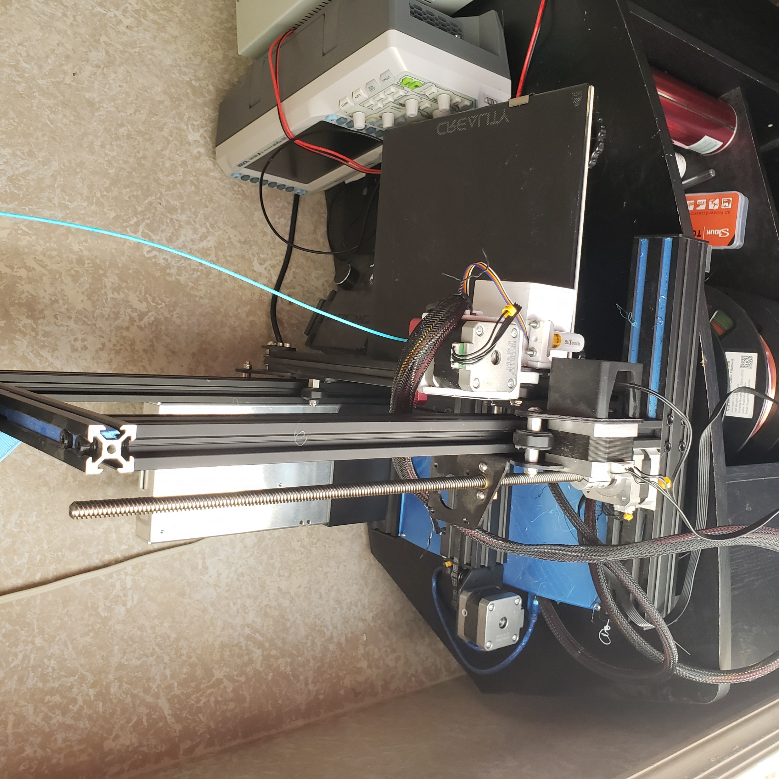
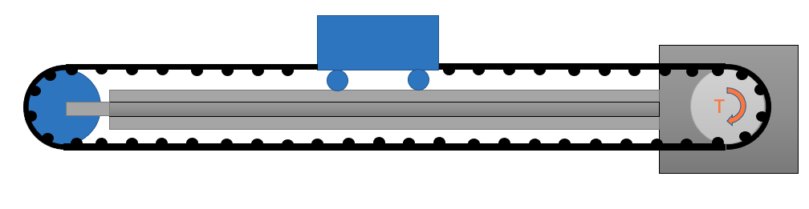
Initial Concept Generation
Cartesian system
Belt/pulley combination with counterweight for Z-axis
Fail-safe latches at top and bottom of printer to prevent bottoming-out
Mount motors outside heated chamber, cool other motors with Peltier Plates
Space heater heating element
Surrounded by insulation

Slide 6
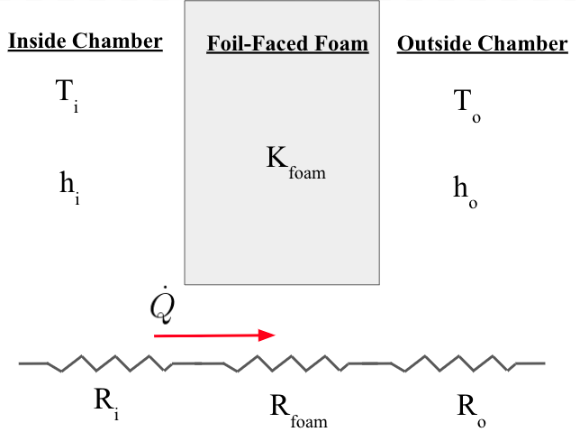
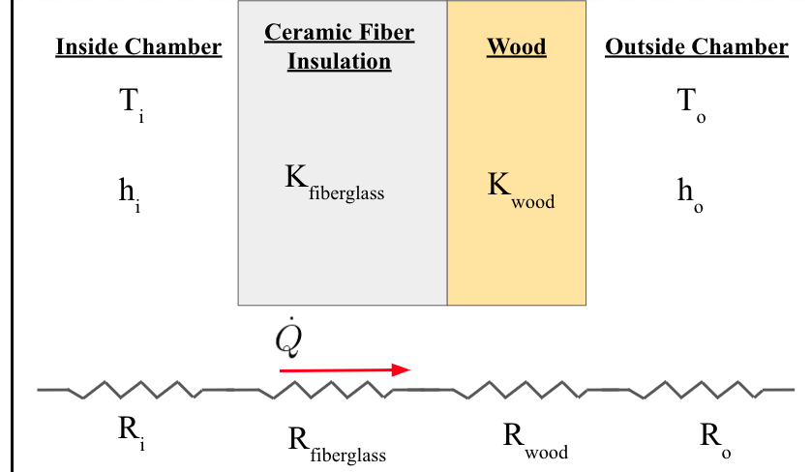
Preliminary Thermal Analysis
Method 1
Method 2
3”
1”
¼”
Cons
Flaky
Bulky
Pros
Less Volume
Sturdy
Clean
Cons
Worse Insulator
Pros
Better Insulator (larger thickness)

Slide 7
Next Steps
CAD Frame and Components
Assemble movement system in frame
Build Z-axis movement mechanism
Design belt tensioning mechanisms
Get working 3D printer without heated chamber
Perform more complete thermal analysis on heating element

